Slide 1
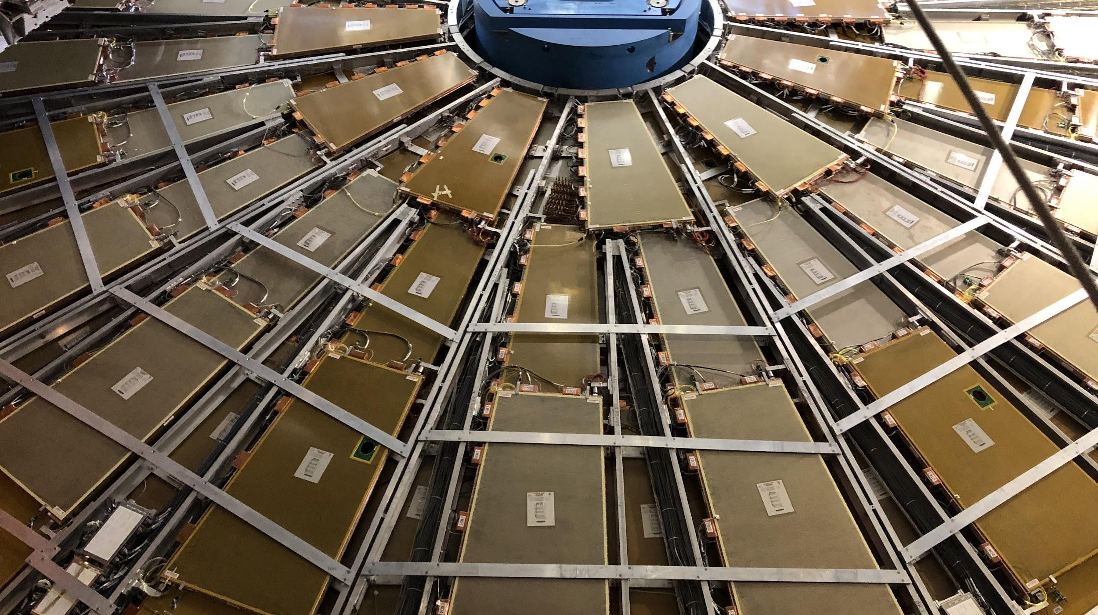

Maintenance Weekly
TileCal Op Meeting, 10 March 2022
Irakli Minashvili, Chris Thomas, Dawit Belayneh, Katie Hughes

Slide 2
MobiDick Testing
LBA02: Reported 100% Dummy error
3 million events, only 1 bad.
LBA45: Reported 70% Dummy error
3 million events: only 2 memory errors in DMU 12, 13; and 1 format error in DMU 1, 2, 3
LBA52: Reported 100% Dummy error
PMT39 LG is bad
3 million events, no errors
LBC17: Reported Digital Errors 50%
We confirmed the problem in DMU 3.

Slide 3
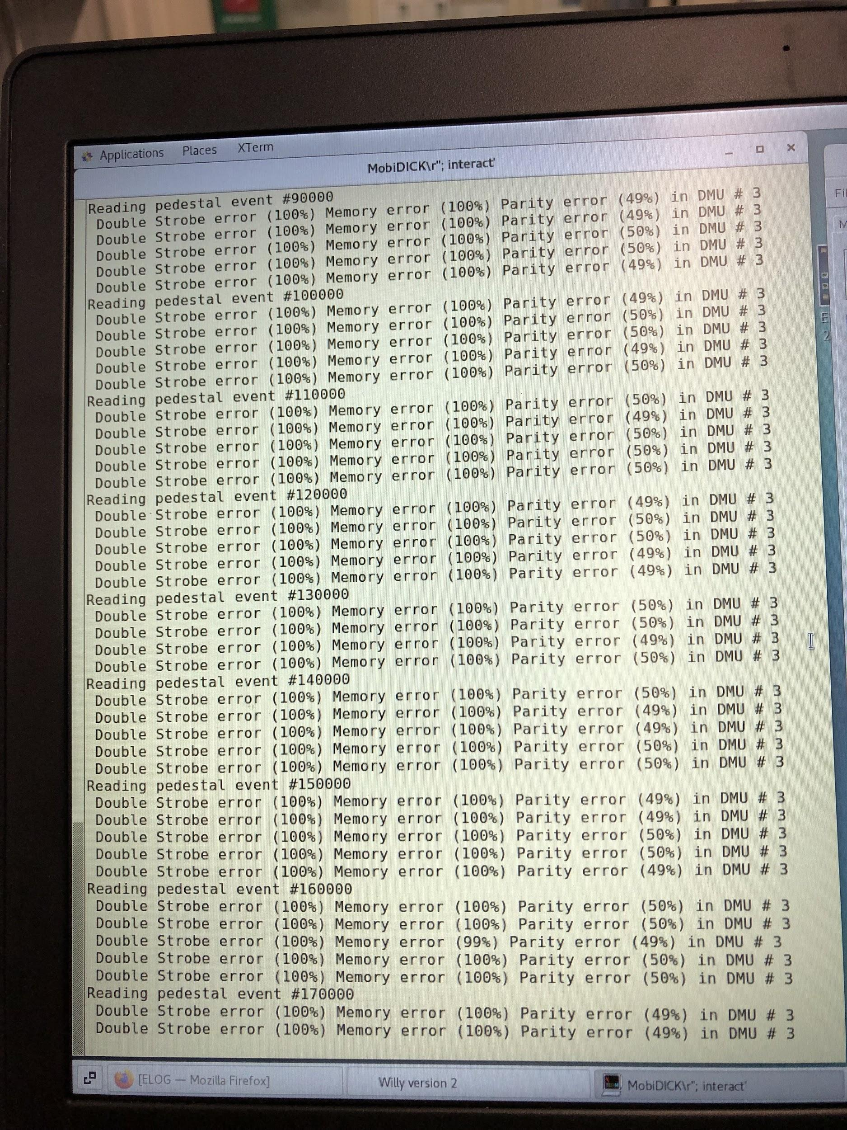
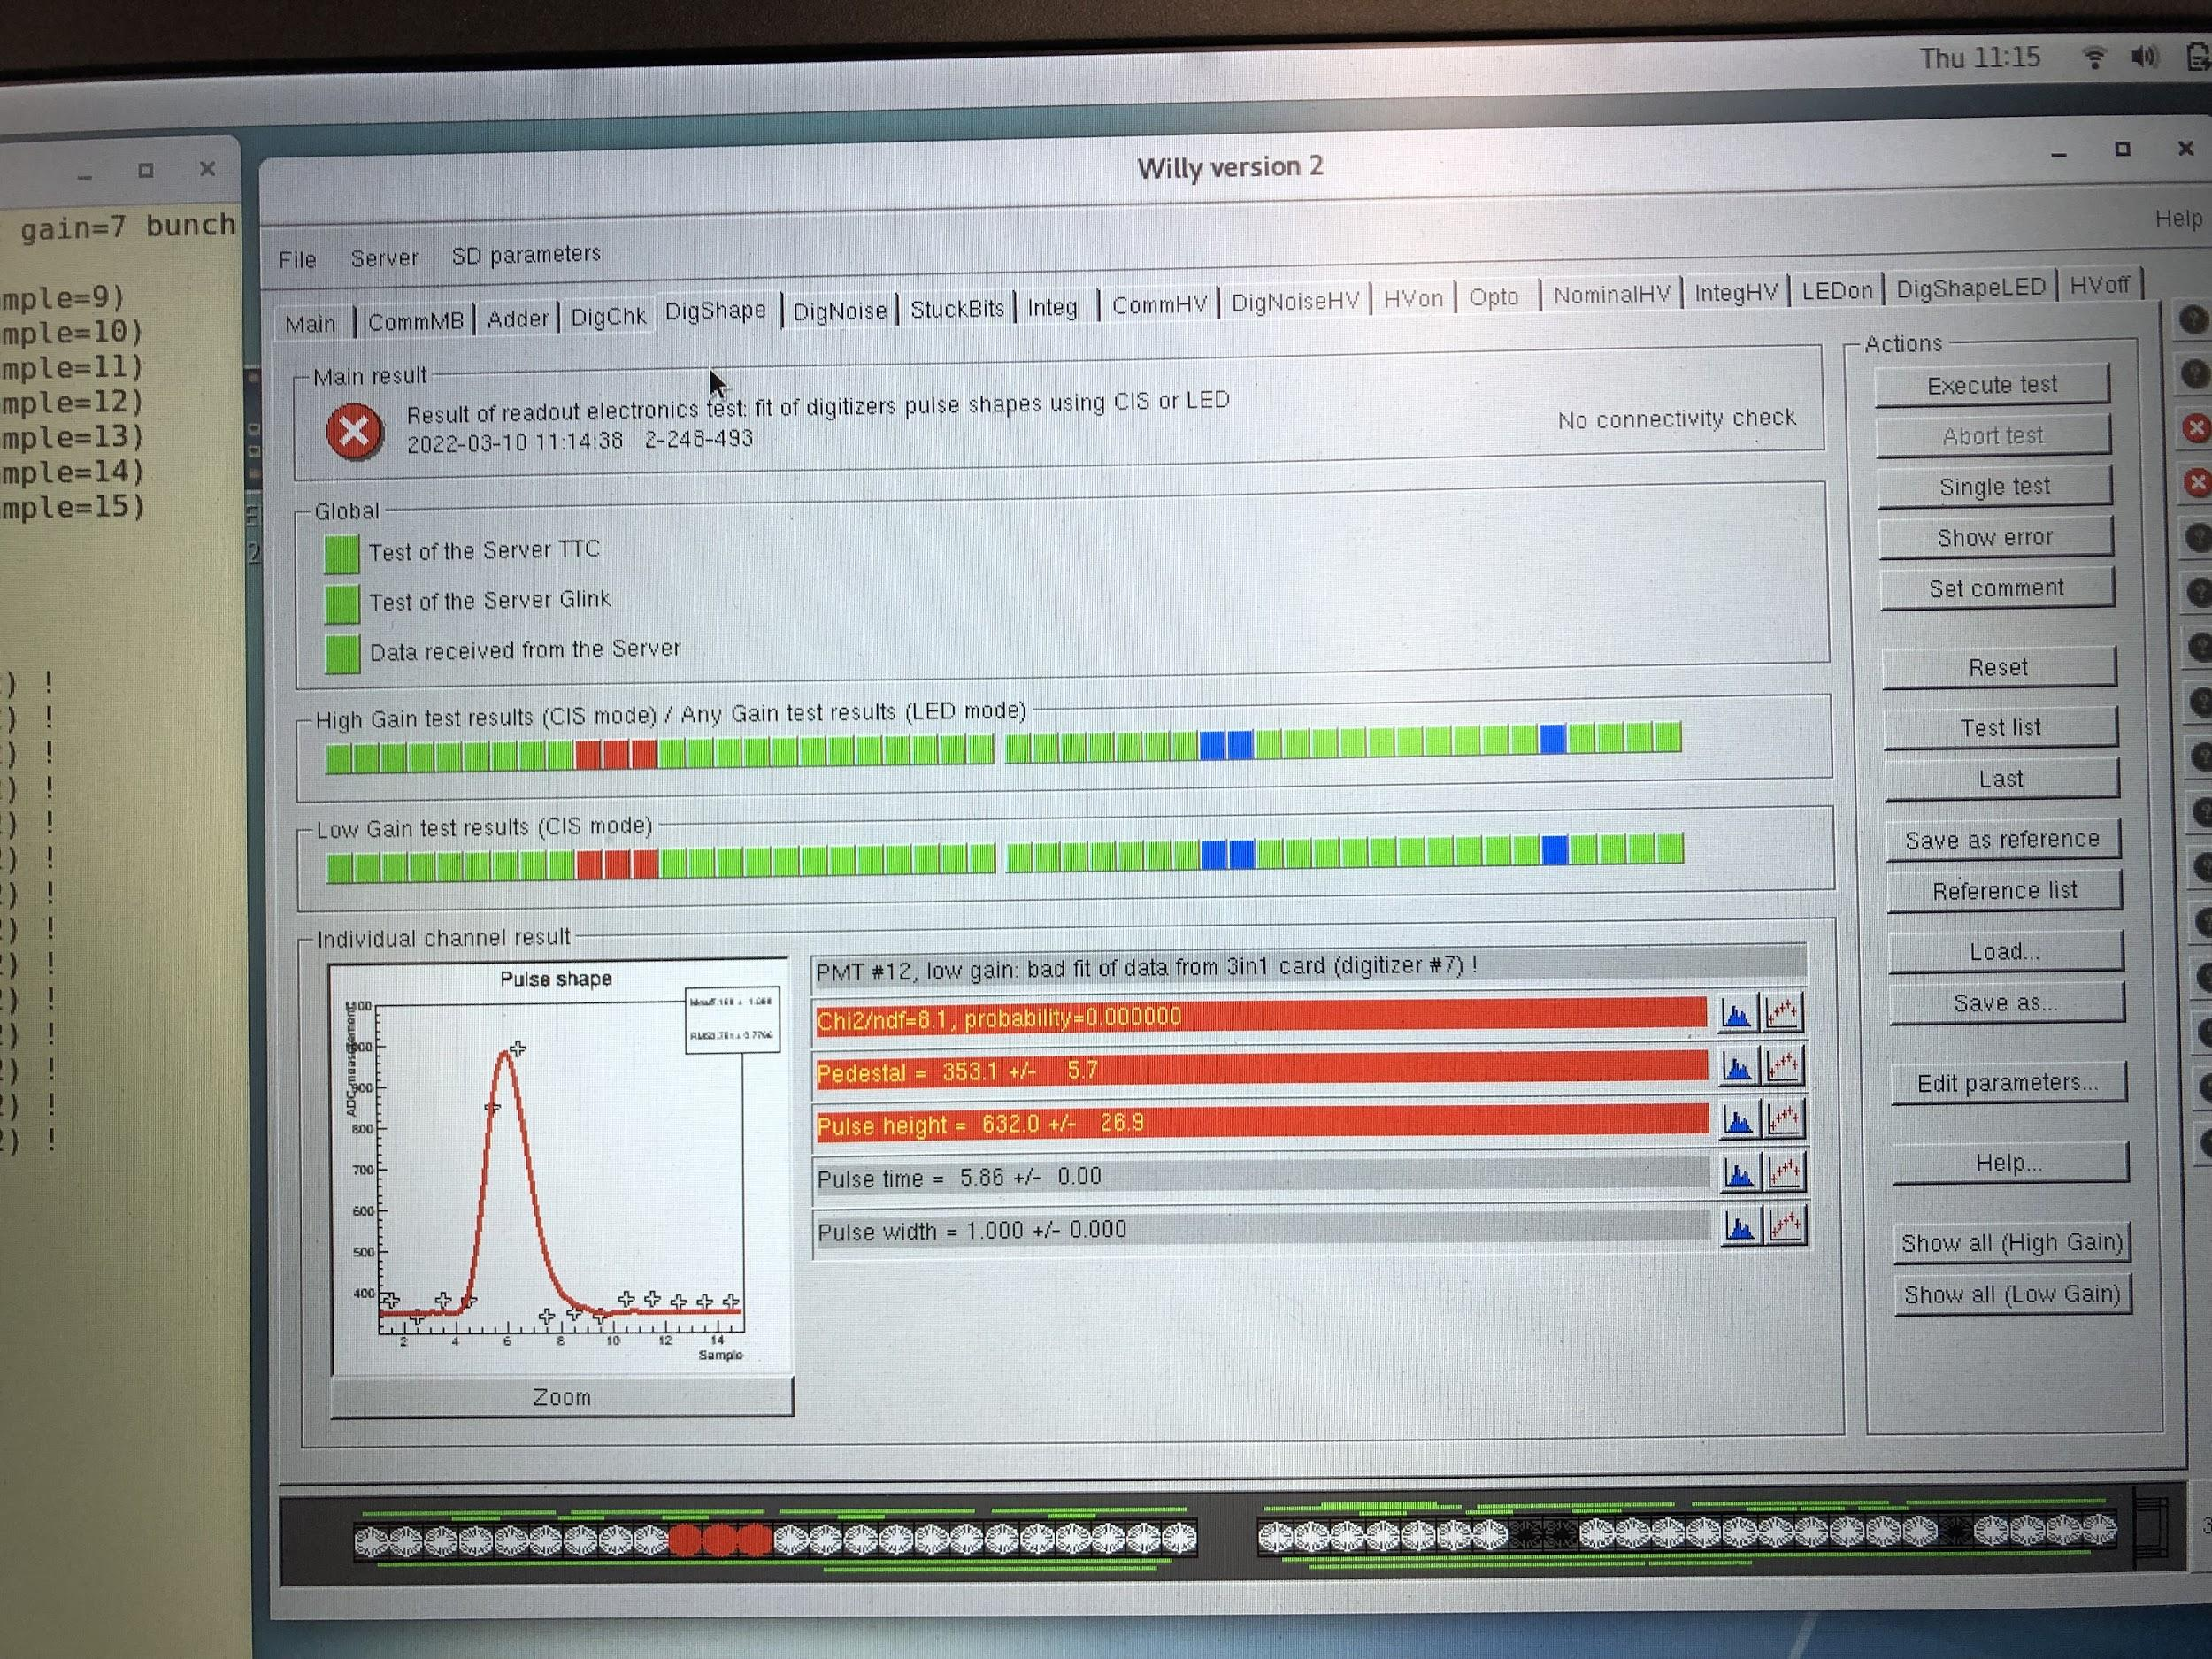
LBC17

